Slide 1




Meet the Teacher
Monday 6th July

Slide 2

About Mr Walker and Ms Sookoo

Slide 3
What to expect in Year 6
Curriculum
Reading
By the end of Year 6, children should be able to:
Reads fluently and confidently across a wide range of texts.
Understands and responds to fiction, non-fiction and poetry.
Retrieves and records information accurately.
Makes inferences using evidence from the text.
Predicts events using stated and implied details. Identifies themes, conventions and patterns in texts.
Summarises key ideas clearly and concisely.
Explains vocabulary and the effect of authors' language choices.
Discusses how language, structure and presentation create meaning.
Compares texts and justifies opinions with evidence.
Reads aloud with fluency, expression and understanding.

Slide 4
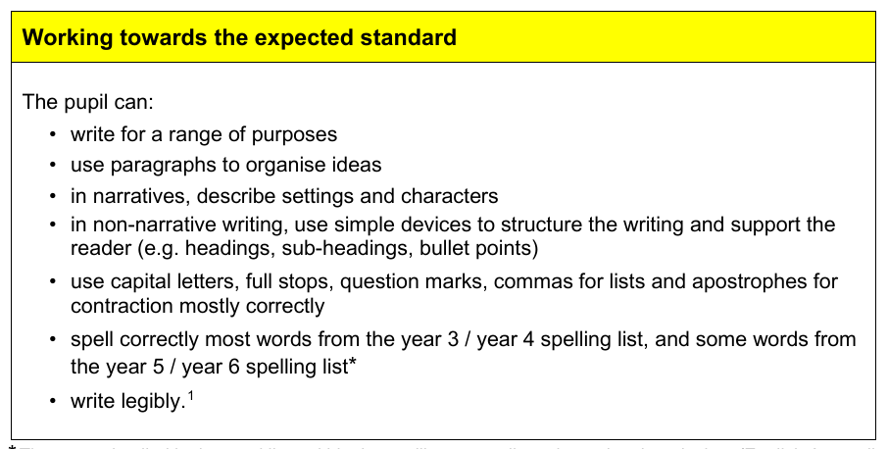
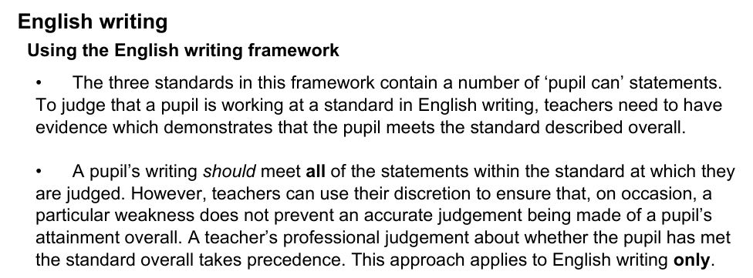
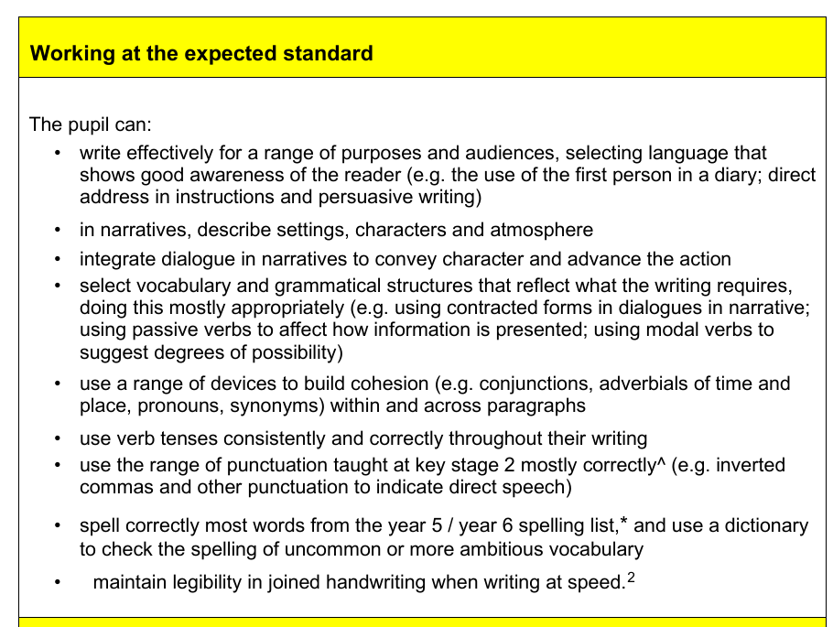
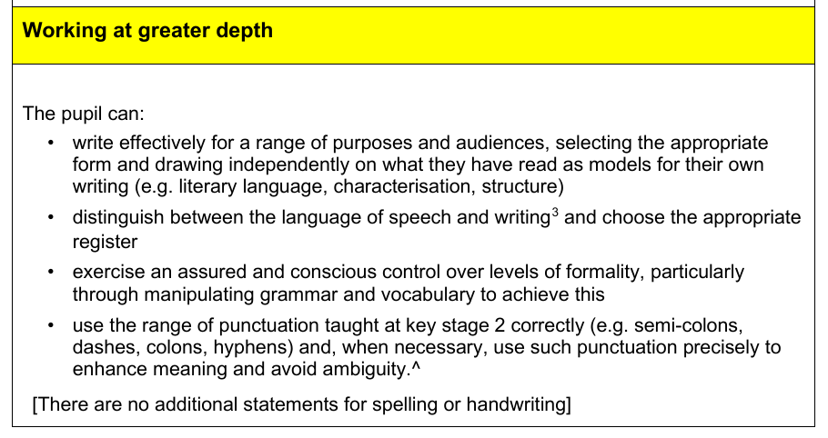
What to expect in Year 6
Curriculum
Writing – TAF framework KS2
Children will learn to:

Slide 5
What to expect in Year 6
Curriculum
Mathematics
Demonstrates secure understanding of place value and the four operations.
Calculates fluently using written and mental methods.
Applies knowledge of fractions, decimals and percentages confidently.
Solves problems involving ratio, proportion and simple algebra.
Measures and calculates with length, mass, capacity, time, area, perimeter and volume.
Converts between units of measure accurately.
Understands the properties of 2D and 3D shapes, angles and position.
Draws, interprets and analyses a range of graphs and charts.
Uses reasoning and problem-solving skills to explain mathematical thinking.
Applies mathematical knowledge confidently to a range of real-life contexts.
Works accurately, efficiently and independently.
Is well prepared for the mathematical demands of secondary school.

Slide 6
Clothing Expectations
P.E Kit
-black shorts/leggings/trousers, white P.E top (logo) and black jacket, trainers
Uniform
-white polo top, grey shorts/trousers, pinafore/skirt and jumper (logo), grey/white/black/navy socks, black shoes
-

Slide 7
Times of the Day/ Typical Day
-8:45am- gates open – please line up outside Y6
-8:50-9:30- Maths starter activity + GPS activity/Read
9:30-10:35-Maths
10:35-10:55- Snack and break
10:55-12:15- Guided Reading/Spelling and English
11:55-12:15 Reading/ Guided Reading
12:15-1:00- Lunch
1:00-1:20- Collective Worship
1:20-3:15-Foundation Curriculum (History/Geography/P.E/ R.E/ Science/MFL/Music/PSHE/Computing/Art/D.T etc)

Slide 8
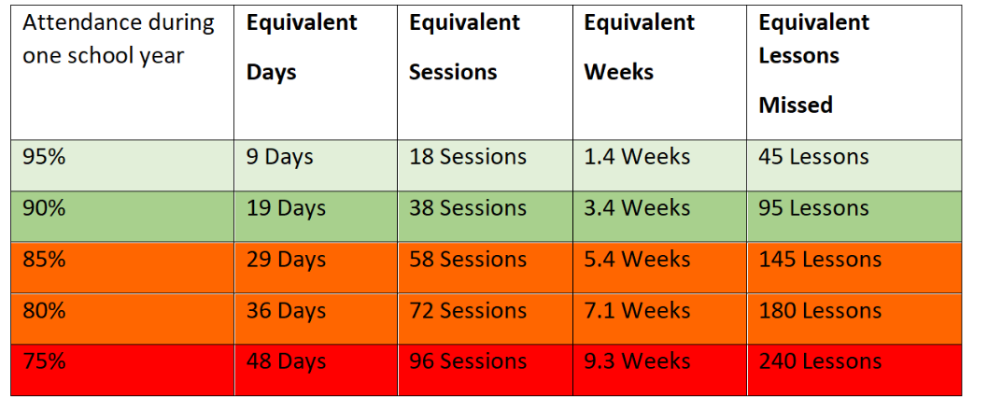
Attendance
Education is a priority so it is important your child is in school as much as possible.
Please arrive promptly so children feel settled and are ready to learn for their starter activity.
Encourage your child to come to school every day unless poorly. Even if they are showing signs of upset, they are often fine once through the door!

Slide 9
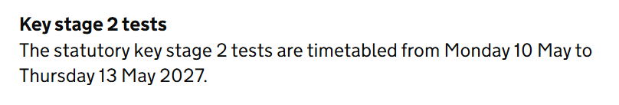
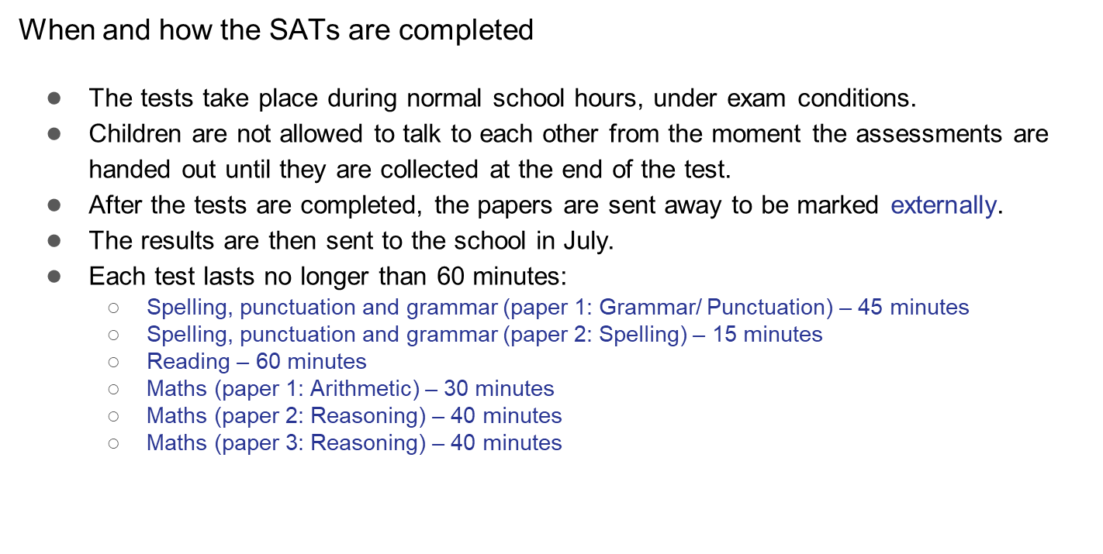
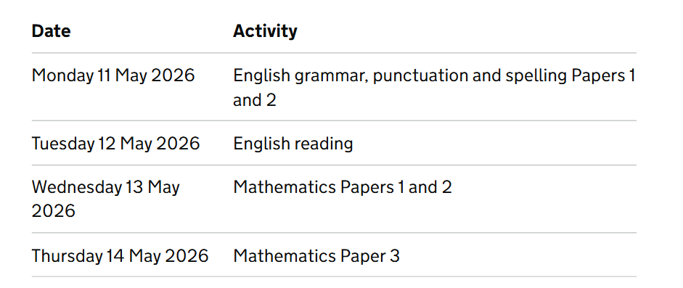
SATS
-
SATs are the Standardised Assessment Tests that are given to children at the end of Key Stage 2.
Please do not book any time off before or during this time.
Last year 25-26

Slide 10
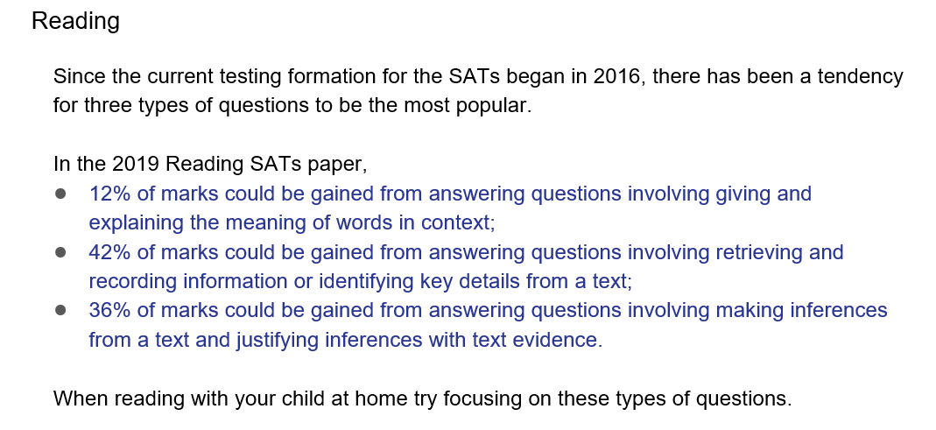
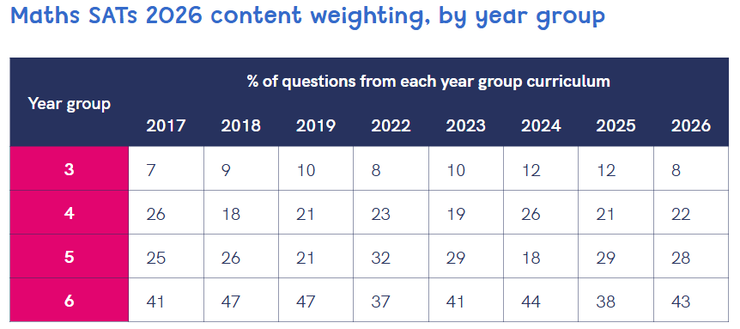
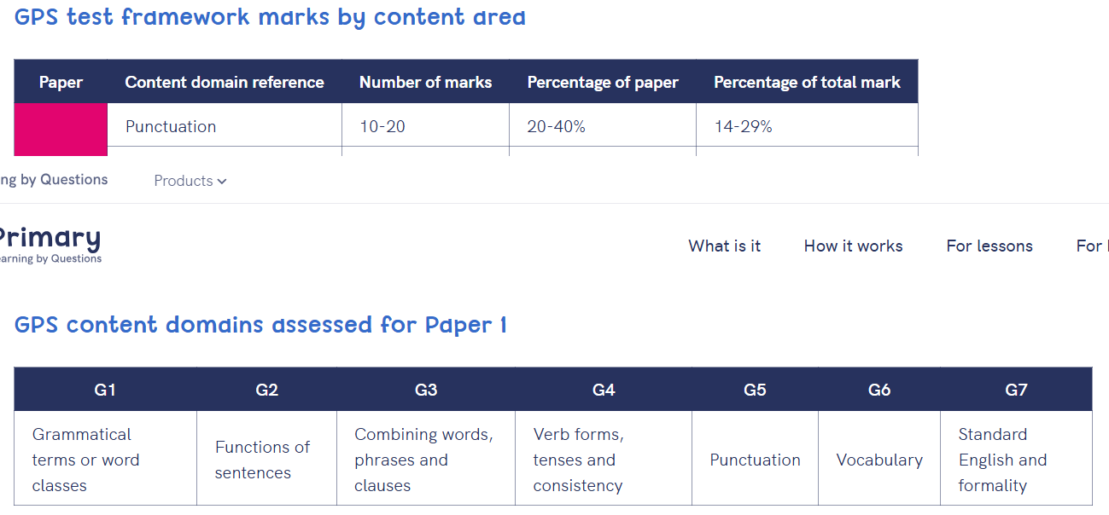
SATS
-

Slide 11
SATS
-
Things to remember about SATs
SATs focus on what children know about Maths and English.
They will not reflect how talented they are at science, geography, art, PE…, and they certainly won’t highlight all of their amazing personal characteristics!
SATs don’t tell the whole story.
Their results will say if they did or did not meet a certain standard but not necessarily by what margin. These thresholds change each year according to the overall national performance, so what was classed as ‘meeting the expected standard’ this year might not be the same as last year. Your school may be able to provide you with more detailed feedback.

Slide 12
Home support
TT Rockstars X5 and U R brainy additional support)
Number – Multiplication and Division ✓ Core focus (all objectives rely on rapid recall of times tables).
Fractions ✓ Equivalent fractions, simplifying, comparing, multiplying and dividing fractions all require multiplication facts.
Decimals ✓ Multiplying and dividing by 10, 100 and 1,000, and calculations involving decimal numbers.
Percentages ✓ Finding percentages of amounts (e.g. 25%, 50%, 75%, 10%) using multiplication and division facts.
Ratio and Proportion ✓ Simplifying ratios, scaling up and down, and solving proportion problems.
Algebra ✓ Finding missing values and understanding multiplicative relationships.
Measurement ✓ Area, volume, unit conversions and compound calculations often require multiplication facts.
Geometry ✓ Less direct, but calculations involving scale, coordinates and angle problems may use multiplication.
Statistics ✓ Interpreting data occasionally requires multiplication when calculating totals or comparing values.
Problem Solving and Reasoning ✓ Multiplication facts are applied across multi-step problems in all areas of mathematics.
Spellingframe- in preparation for weekly spelling tests
Reading- 5 times a week

Slide 13
Home support
You can further support your child by:
📖 Reading together for at least 15–20 minutes each day.
✏️ Encouraging neat handwriting and regular writing opportunities.
➗ Practising multiplication and division facts up to 12 × 12.
💬 Talking about what they have learned at school.
🌍 Visiting libraries, museums and places of interest.
🎲 Playing board games and maths games to develop problem-solving skills.
Supporting independence and organisation skills
😊 Encouraging independence, resilience and a positive attitude towards learning.

Slide 14
Any questions......
Notes:
Any Questions?

