Slide 1

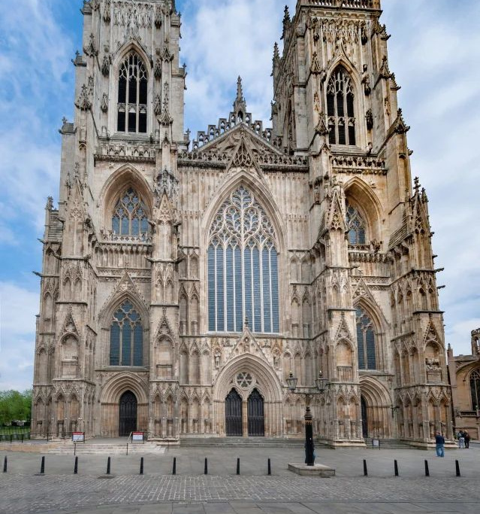
Year 6 York Residential
Little Sutton CE Primary School trip: 21–23 October 2026

Slide 2
Where we stay and travel
Wheatlands Lodge Hotel, York
Wheatlands Lodge Hotel, 75-85 Scarcroft Rd, York YO24 1DB
Tel. 01904 654318
Wheatlands Lodge Hotel
Our private base is the comfortable Wheatlands Lodge Hotel on Scarcroft Road, offering dedicated en-suite rooms, hearty cooked breakfasts, and evening meals together.
Coach travel: 37-seater coach operated by Alpine Travel throughout.
City centre: Drop-offs are at St George's Field due to pedestrian zones.
WEDNESDAY 21ST OCTOBER 2026
07:20hrs – please arrive at school
07.45 hrs - The coach will arrive at the school to load the luggage
8am – coach leaves

Slide 3
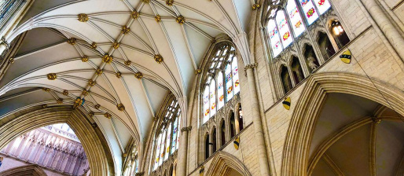
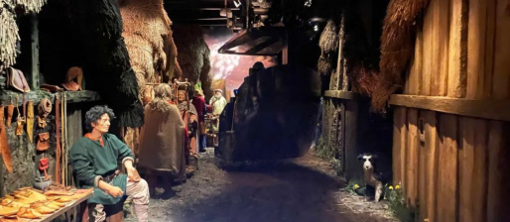
Day 1: Vikings and Minster
York Minster & The Shambles
Depart school at 08:00. Self-led exploration of the Minster, followed by spotting the iconic shops along The Shambles and lunch at Friargate.
DIG & JORVIK Viking Centre
Hands-on excavation and Battle Tactics workshop at DIG (13:45), followed by riding through 10th-century Viking streets at JORVIK (16:15).

Slide 4




Day 2: Castles, chocolate and ghosts
York Castle Museum
10:00 visit. Reconstructed Victorian streets, period rooms, and packed lunch in the Dick Turpin room.
York's Chocolate Story
12:30 entry. Discovering York's confectionery heritage, how cocoa is made, and sampling treats.
York Dungeons
14:40 visit. Live costumed actors sharing York's thrilling and dramatic folklore with theatrical flair.
Original Ghost Tour
19:30 evening walk tailored specially for school pupils, starting from Clifford's Tower and finishing at the Minster.

Slide 5
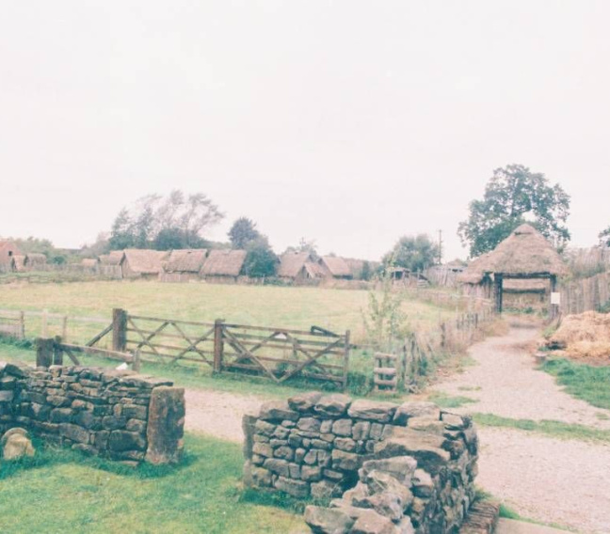
Day 3: World War II home front
Murton Park Home Front Day
After hotel check-out, we spend Friday (10:00–15:15) experiencing life as wartime child evacuees in 1939.
Evacuation co-ordinator: Discovering billet assignments and daily rationing.
ARP Warden drill: Practising air-raid sirens, gas mask drills, and incendiary bomb safety.
Homeward journey: Depart 15:15; return to school at approximately 18:30.

Slide 6
Essential packing and routines
Sensible footwear & waterproofs: York is pedestrianised, so comfortable walking shoes and warm layers are vital.
1
Dietary requirements & medication: All dietary needs and prescribed medicines must be logged with staff in advance.
2
Day bag & packed lunch: A small backpack for packed lunches and water bottles during daily walking tours.
3

Slide 7
School and contact information
Little Sutton C of E: 0151 312 8338
Conker Club Phone Number:
07395286433 for emergencies only

Slide 8

Parent Questions and Readiness
Thanks for listening.
Any questions?

